Slide 1
Penatalaksanaan Dislipidemia Statin sebagai salah satu modalitas terapi

Slide 2
Lipoprotein
Kompleks Makromolekuler yang berfungsi membawa lipid hidrofobik (Trigliserida, kolesterol, vitamin larut lemak) melalui cairan tubuh (plasma, cairan interstisial dan limfe) dari dan ke jaringan
Sumber : Harrison Principles of Internal Medicine

Slide 3
Target
NCEP ATPIII :
LDL kolesterol < 100mg/dL pada penderita CHD
Pasien dengan estimate 10 years absolute risk CHD → CHD risk equivalent
Pasien dengan 2 atau lebih faktor resiko dan 10 year absolute risk 10-20% → target LDL<130 mg/dL atau (opsional) sd<100 mg/dL
Sumber : Harrison Principles of Internal Medicine

Slide 6
Risk Factor CHD
Age. Simply getting older increases your risk of damaged and narrowed arteries.
Sex. Men are generally at greater risk of coronary artery disease. However, the risk for women increases after menopause.
Family history. A family history of heart disease is associated with a higher risk of coronary artery disease, especially if a close relative developed heart disease at an early age. Your risk is highest if your father or a brother was diagnosed with heart disease before age 55, or your mother or a sister developed it before age 65.
Smoking. Nicotine constricts your blood vessels, and carbon monoxide can damage their inner lining, making them more susceptible to atherosclerosis. The incidence of heart attack in women who smoke at least 20 cigarettes a day is six times that of women who've never smoked. For men who smoke, the incidence is triple that of nonsmokers.
http://www.mayoclinic.com/health/coronary-artery-disease/DS00064/DSECTION=risk-factors

Slide 7
Risk Factor CHD
High blood cholesterol levels. High levels of cholesterol in your blood can increase the risk of formation of plaques and atherosclerosis. High cholesterol can be caused by a high level of low-density lipoprotein (LDL), known as the "bad" cholesterol. A low level of high-density lipoprotein (HDL), known as the "good" cholesterol, also can promote atherosclerosis.
Diabetes. Diabetes is associated with an increased risk of coronary artery disease. Both conditions share similar risk factors, such as obesity and high blood pressure.
Obesity. Excess weight typically worsens other risk factors.
Physical inactivity. Lack of exercise also is associated with coronary artery disease and some of its risk factors, as well.
High stress. Unrelieved stress in your life may damage your arteries as well as worsen other risk factors for coronary artery disease.
http://www.mayoclinic.com/health/coronary-artery-disease/DS00064/DSECTION=risk-factors

Slide 8
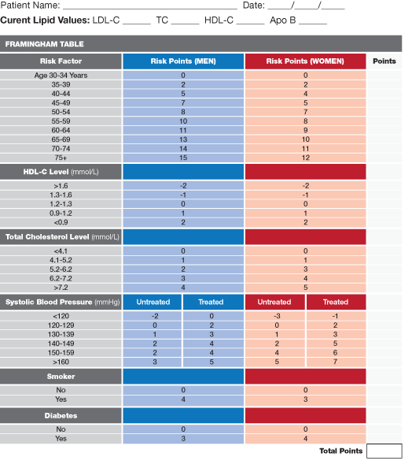
Framingham Risk Scoring
http://www.cvtoolbox.com/cvtoolbox1/risk_calc/rc.html

Slide 9
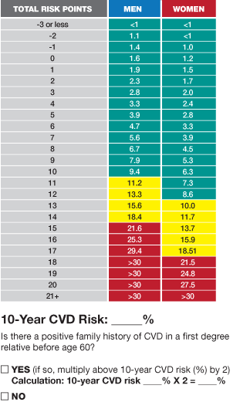
http://www.cvtoolbox.com/cvtoolbox1/risk_calc/rc.html

Slide 10
Penyebab Sekunder Dislipidemia
LDL |  | HDL |  | Peningkatan VLDL | Peningkatan IDL | Peningkatan Chylomicron | Peningkatan Lp(a)
Peningkatan | Menurun | Peningkatan | Menurun
Hipotiroidisme Sindroma nefrotik Kolestasis Acute intermittent porphyria Anorexia nervosa Hepatoma Obat (Thiazid, tegretol) | Penyakit liver berat Malabsorbsi Malnutrisi Infeksi kronis Gaucher’s diasease Hyperthyroidisme Obat: toksisitas niasin | Alkohol Olah raga Paparan pada chlorinated hydrocarbon Obat: estrogen | Merokok DM tipe 2 Obesitas Malnutrisi Gaucher’s disease Obat: anabolik steroid, beta bloker | Obesitas DM tipe 2 Glicogen storage disease Hepatitis Alkohol Gagal ginjal Sepsis Stress Cushing syndrome Kehamilan Acromegali Lipodistrophy Obat: estrogen, steroid Bile acid binding resin, asam retinoat | Multiple myeloma Monoclonal gammopathy Autoimmune disease Hypothyroidisme | Autoimmune disease DM tipe 2 | Gangguan fungsi ginjal Keradangan Menopause Orchidectomi Hipothyroidisme Acromegaly Nephrosis Obat: growth hormone isotretinoin
Sumber : Harrison Principles of Internal Medicine

Slide 11
Jenis Obat | Indikasi Utama | Dosis awal | Dosis Maksimal | Mekanisme | Efek samping tersering
HMG-CoA reductase inhibitor (statin) Lovastatin Pravastatin Simvastatin Fluvastatin Atorvastatin Rosuvastatin | Peningkatan LDL kol | 20 mg 40 mg 20 mg 20 mg 10 mg 10 mg | 80 80 80 80 80 40 | ↙ sintesa kolesterol ↗reseptor LDL hepar ↙Produksi VLDL | Arthralgia, myalgia, peningkatan transaminase, dispepsia
Cholesterol absorption inhibitor Ezetimibe | Peningkatan LDL kolesterol | 10 mg | 10 mg | ↙ absorpsi kolesterol di sal cerna | Peningkatan transaminase
Bile acid sequestran Colestiramin Colestipol Colesevam | Peningkatan LDL kolesterol | 4 g 5 g 3750 mg | 32 g 40 g 4375 mg | ↗ ekskresi as. Empedu ↗ reseptor LDL | Kembung, konstipasi, peningkatan trigliserida
Sumber : Harrison Principles of Internal Medicine

Slide 12
Nama Obat | Indikasi Utama | Dosis awal | Dosis maksimal | Mekanisme | Efek samping tersering
Asam Nicotinat Immediate release Sustained release Extended release | Peningkatan LDL, HDL rendah, peningkatan TG | 100 mg 250 mg 500 mg | 1 gram 1.5 gram 2 gram | ↘ sintesis VLDL hepar | Flushing, gangguan sal cerna, peningkatan glukosa, asam urat dan transaminase
Derivat asam fibrate Gemfibrozil Fenofibrate | Peningkatan TG, peningkatan remnants | 600 mg 145 mg | 600 mg 145 mg | ↗LPL, ↘ sintesis VLDL | Dispepsia, myalgia, batu GB, peningkatan transaminase
Asam Lemak Omega 3 | Peningkatan TG | 3 gram | 6 gram | ↗katabolisme TG | Dispepsia, diare, bau mulut
Sumber : Harrison Principles of Internal Medicine

Slide 14
Acetyl CoA
HMG-CoA reductase (or 3-hydroxy-3-methyl-glutaryl-CoA reductase
HMG CoA
HMG CoA Reductase
Mevalonate
Mevalonate kinase
Mevalonate Pirophosphate
Isopentenyl Pirophosphate
Geranyl Pirophosphate
Parnesyl Pirophosphate
Squalene
Ubiquinone
Cholesterol
Dolichol

Slide 15
Acetyl CoA
HMG CoA
HMG CoA Reductase
Mevalonate
Mevalonate kinase
Mevalonate Pirophosphate
Isopentenyl Pirophosphate
Geranyl Pirophosphate
Parnesyl Pirophosphate
Squalene
Ubiquinone
Cholesterol
Dolichol

Slide 16
Kombinasi Obat
Gagal mencapai kadar kolesterol LDL dan HDL optimal
Peningkatan LDL dan Trigliserida pada satu pasien
Pasien hipertrigliseridemia, yang tdk mencapai kadar kolesterol non HDL optimal dengan terapi fish oil atau fibrat sebagai monoterapi
Kombinasi Fibrat dan Statin belum banyak diteliti
Efek samping myopati meningkat sd 2.5%
Sumber : Harrison Principles of Internal Medicine

Slide 17
TERIMA KASIH

Slide 18
Pemeriksaan Laboratorium untuk Lipid
Tes enzimatik untuk Total kolesterol dan Trigliserida
LDL kolesterol = kolesterol total-(Trigliserida/5)-HDL kolesterol

Slide 19
Dislipidemia pada penderita Diabetes
Tipe I : Jarang terjadi bila kadar gula terkendali
Pada KAD terjadi akibat peningkatan influks asam lemak dari jaringan adiposa
Tipe II : Umumnya didapatkan dislipidemia walaupun kadar gula normal
Diakibatkan :
Penurunan LPL → menurunkan katabolisme VLDL dan chylomycron
Peningkatan pelepasan asam lemak bebas dari jaringan adiposa
Peningkatan sintesa asam lemak di liver
Peningkatan produksi VLDL di liver

Slide 20
Dislipidemia pada alkoholisme
Kadar Trigliserida meningkat
Merangsang sekresi VLDL di liver, menghambat oksidasi FFA di liver→ meningkatkan pembentukan Trigliserida di liver dan meningkatkan sekresi VLDL

Slide 21
